Slide 1
Deliberative democracy or agonism?
An exploration of the role of Twitter in political discourse

Slide 2
Tarnjit Kaur Johal
Arcsine Analytics, Ottawa
Mert Ozer
Department of Computer Science,
Arizona State University

Slide 3
Outline
Define a Habermassian Digital Public Sphere
Adopt a quantitative measure for the nature of discourse: political polarization
Develop and test the algorithm on a case study

Slide 4

Habermassian Digital Public Sphere
Requires :
accessibility,
neutrality,
individual communicative agency
Free of :
(un)intentional influence
censorship
surveillance.
Is Twitter a forum for deliberative exchange and democratic engagement?
Employ Habermas’ conceptual framework of the Public Sphere

Slide 5
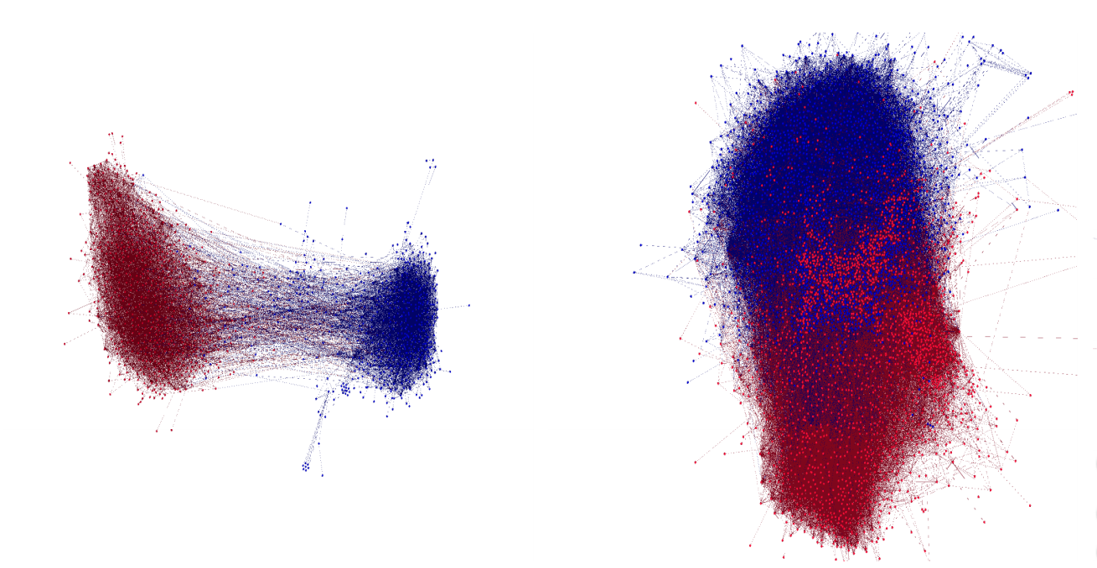
The Political Polarization Metric by Garimella et. al, 2016
Given a 2 sided social network, it quantifies the polarization of the network.

Slide 6
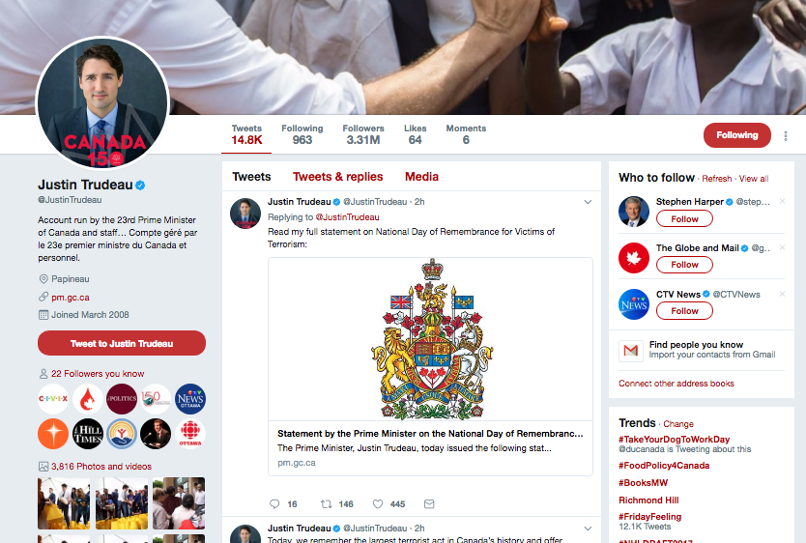

Slide 7
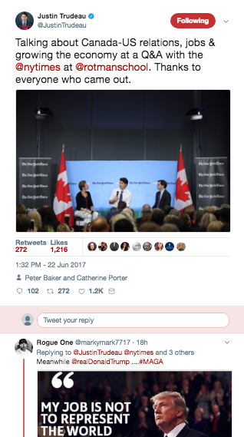
Tweet
Re-Tweet
Mentions

Slide 8
The Political Polarization Metric by Garimella et. al, 2016
Based on a random walk on the given network.
Calculates most central nodes of two sides.
Starts with a random node in the network.
Traverses the network with random walk probabilities.
Measures how many times the walk ends in the opposite side’s most central node.

Slide 9

The Political Polarization Metric by Garimella et. al, 2016
Based on a random walk on the given network.
Calculates most central nodes of two sides.
Starts with a random node in the network.
Traverses the network with random walk probabilities.
Measures how many times the walk ends in the opposite side’s most central node.

Slide 10
The Political Polarization Metric by Garimella et. al, 2016
Based on a random walk on the given network.
Calculates most central nodes of two sides.
Starts with a random node in the network.
Traverses the network with random walk probabilities.
Measures how many times the walk ends in the opposite side’s most central node.

Slide 11
The Political Polarization Metric by Garimella et. al, 2016
Based on a random walk on the given network.
Calculates most central nodes of two sides.
Starts with a random node in the network.
Traverses the network with random walk probabilities.
Measures how many times the walk ends in the opposite side’s most central node.

Slide 12
The Political Polarization Metric by Garimella et. al, 2016
Based on a random walk on the given network.
Calculates most central nodes of two sides.
Starts with a random node in the network.
Traverses the network with random walk probabilities.
Measures how many times the walk ends in the opposite side’s most central node.

Slide 13
The Political Polarization Metric by Garimella et. al, 2016
Based on a random walk on the given network.
Calculates most central nodes of two sides.
Starts with a random node in the network.
Traverses the network with random walk probabilities.
Measures how many times the walk ends in the opposite side’s most central node.
Less likely,
More polarized

Slide 14
The Political Polarization Metric by Garimella et. al, 2016
Based on a random walk on the given network.
Calculates most central nodes of two sides.
Starts with a random node in the network.
Traverses the network with random walk probabilities.
Measures how many times the walk ends in the opposite side’s most central node.

Slide 15
The Political Polarization Metric by Garimella et. al, 2016
Based on a random walk on the given network.
Calculates most central nodes of two sides.
Starts with a random node in the network.
Traverses the network with random walk probabilities.
Measures how many times the walk ends in the opposite side’s most central node.
More likely,
Less polarized

Slide 16
The Political Polarization Metric - Our Intervention
Our interest is small-scale elite networks in this work. Centrality may fail.
We analyse multi-sided political networks.
We start from any random node, and take d steps where d is the diameter of the network.
Measure how many time the walk ends in the same side.
Notes:
Sampling methods of the node
Based on edge of the nodes

Slide 17
Dataset
Crawled the last 3,200 tweets from each parliament member’s Twitter accounts.
2011 Parliament Members
Conservative Party: 136/159
NDP: 81/95
Liberal Party: 36/36
Independent: 7/8
Green: 2/2
Forces et Démocratie: 2/2
Bloc: 1/2
Total: 265/308 Twitter Accounts
2015 Parliament Members
Liberal Party: 183/183
Conservative Party: 98/99
NDP: 44/44
BLOC: 9/10
Green: 1/1
Independent: 1/1
Total: 336/338 Twitter Accounts

Slide 18
How representative is our dataset?
2011 Parliament Members
2015 Parliament Members
Able to capture all historical tweets for 160 accounts out of 265.
Able to capture all historical tweets for 201 accounts out of 332.
Notes:
The MPs conduct on twitter is a controlled and public relations (PR) exercise.
It may be an example of “representative publicness” rather than public discourse.

Slide 19
How representative is our dataset?
2011 Parliament Members
2015 Parliament Members
Able to capture all historical tweets for 160 accounts out of 265.
234 of 265 (%88) accounts tweeted less than 3,200 since 2015.
Able to capture all historical tweets for 201 accounts out of 332.
265 of 332 (%80) accounts tweeted less than 3,200 since 2015.
Notes:
The MPs conduct on twitter is a controlled and public relations (PR) exercise.
It may be an example of “representative publicness” rather than public discourse.

Slide 20
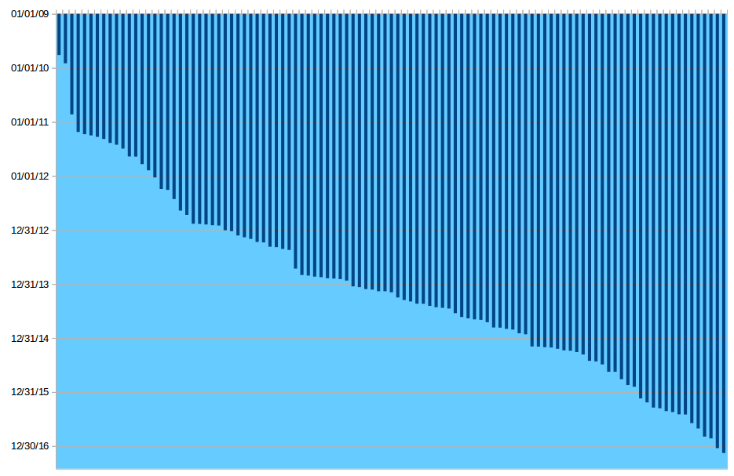
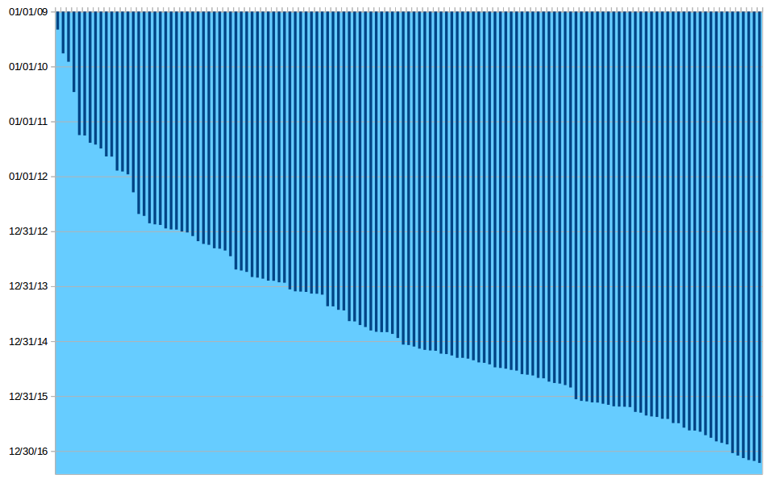
How representative is our dataset?
2011 Parliament Members
2015 Parliament Members
Able to capture all historical tweets for 160 accounts out of 265.
234 of 265 (%88) accounts tweeted less than 3,200 since 2015.
Rest;
Able to capture all historical tweets for 201 accounts out of 332.
265 of 332 (%80) accounts tweeted less than 3,200 since 2015.
Rest;
Time
decreasing
We analyse tweets since 2015
Notes:
The MPs conduct on twitter is a controlled and public relations (PR) exercise.
It may be an example of “representative publicness” rather than public discourse.

Slide 21
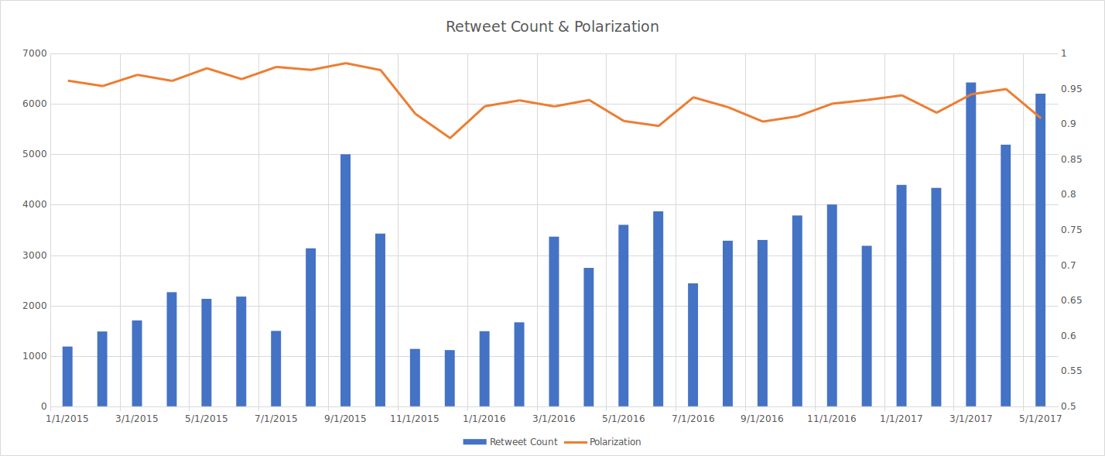
Monthly Polarization Trends - Retweet Behaviour

Slide 22
Monthly Polarization Trends - Retweet Behaviour

Slide 23
Monthly Polarization Trends - Retweet Behaviour
Sudden decline in polarization after the election

Slide 24
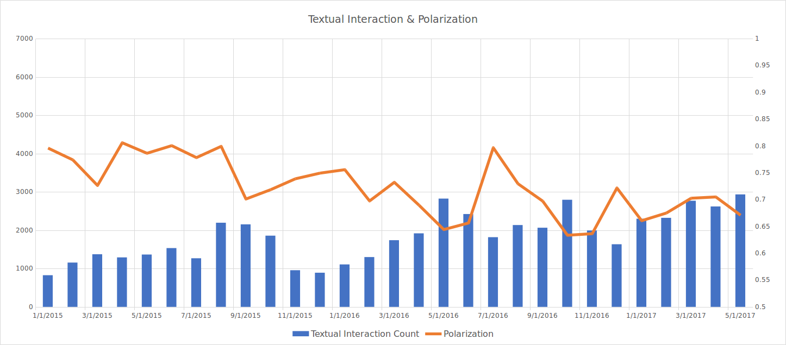
Monthly Polarization Trends - Mentioning Behaviour

Slide 25
Monthly Polarization Trends - Mentioning Behaviour
Less Polarized
Compared to Retweeting Behaviour

Slide 26
Monthly Polarization Trends - Mentioning Behaviour
Less Interaction Compared to Retweeting Behaviour

Slide 27
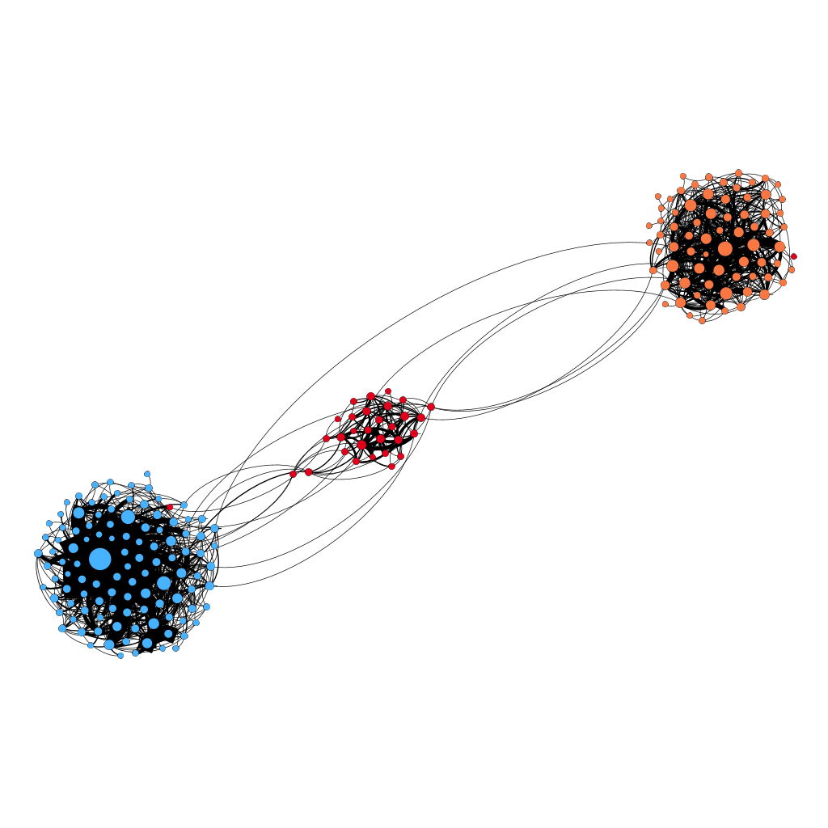
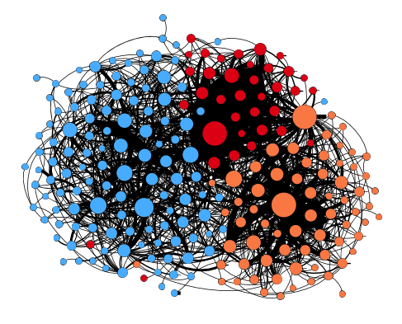
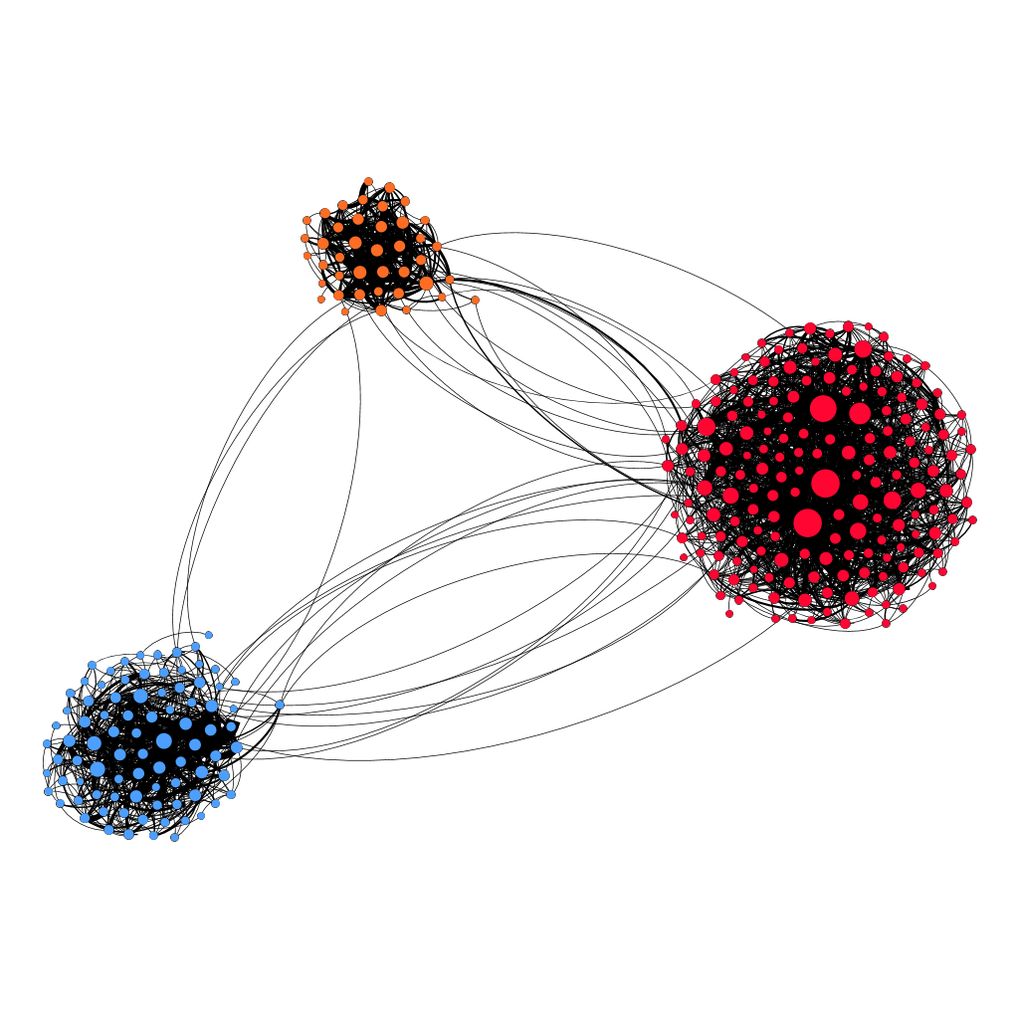
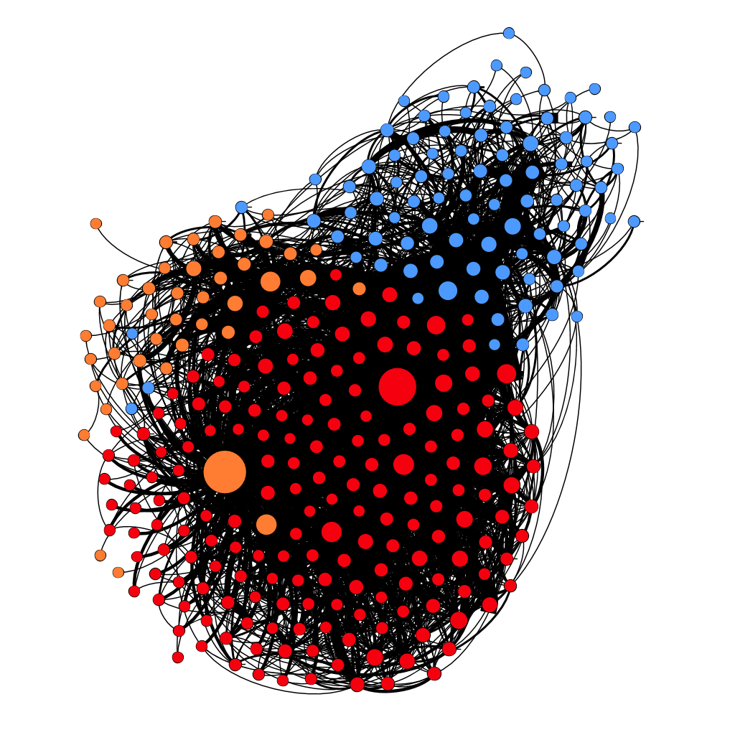
Issue-Based Polarization Cases - #cdnpoli
2011 Parliament Retweet
2011 Parliament Mention
2015 Parliament Retweet
2015 Parliament Mention
Polarization: 0.955
Polarization: 0.565
Polarization: 0.965
Polarization: 0.692
Liberal
NDP
Conservative
Cross-party retweets are observed.
Mention networks are much less polarized.
Hashtag #cdnpoli serves as a broad mediator of discussion and interaction about canadian politics.

Slide 28
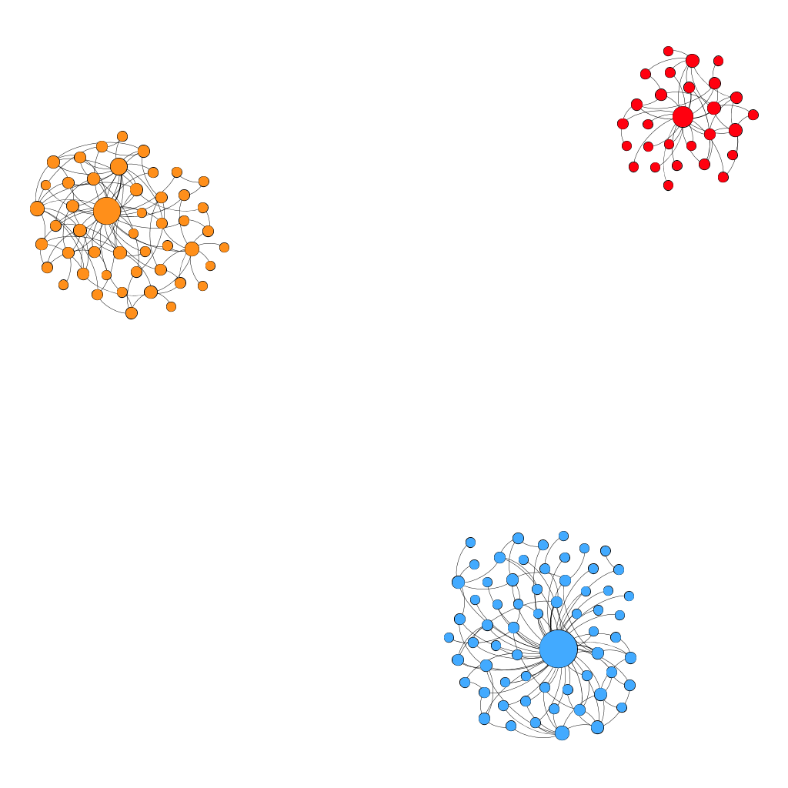
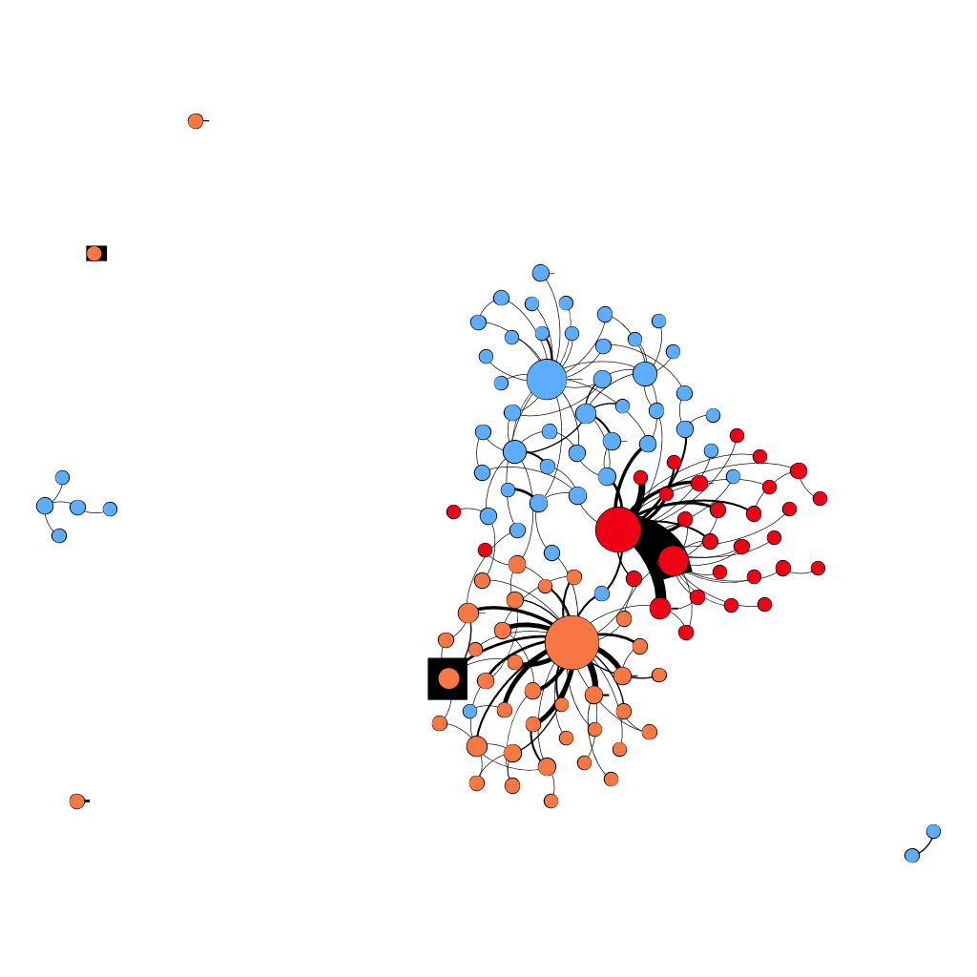
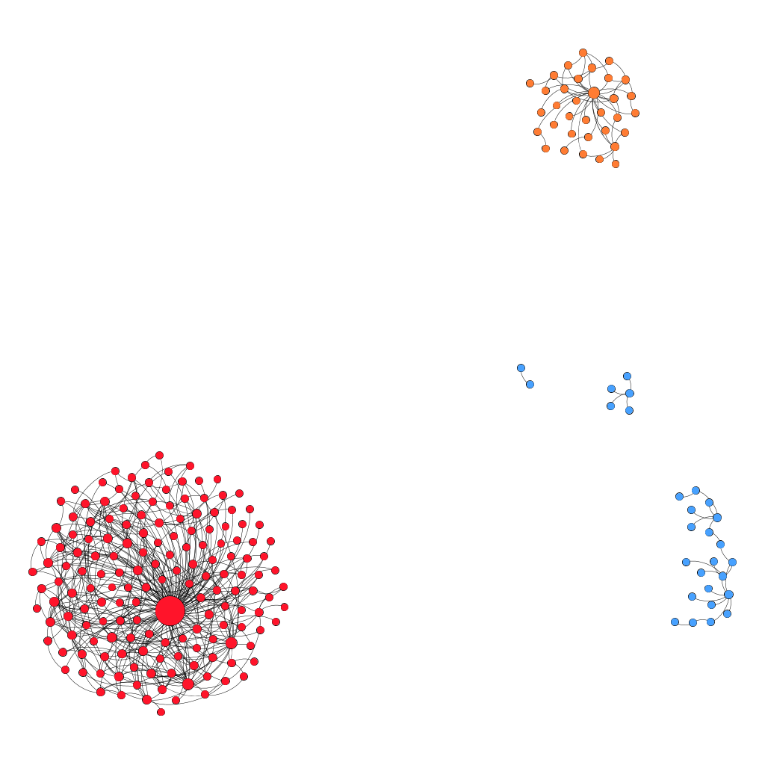
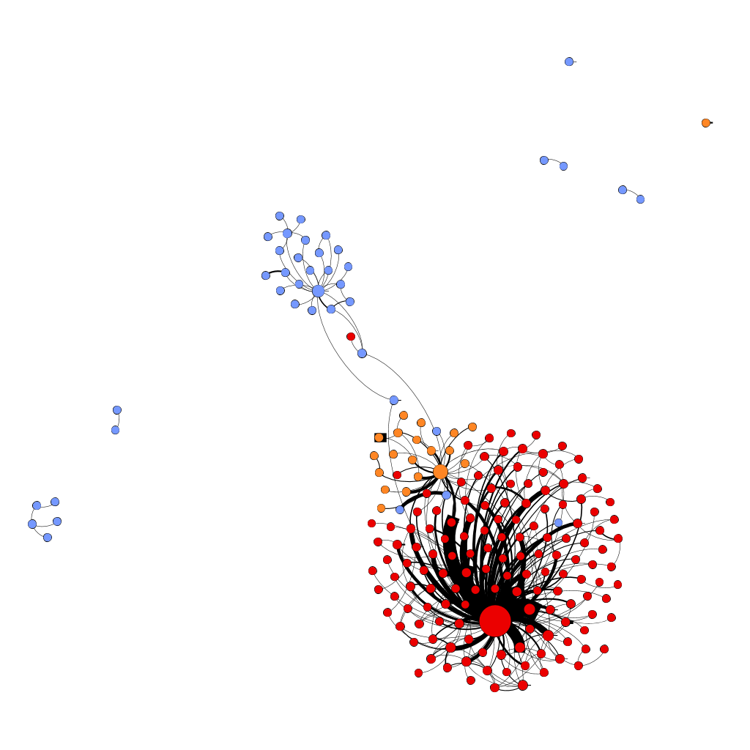
Issue-Based Polarization Cases - #elxn42 (Election)
2011 Parliament Retweet
2011 Parliament Mention
2015 Parliament Retweet
2015 Parliament Mention
Polarization: 1.0
Polarization: 0.807
Polarization: 1.0
Polarization: 0.886
Liberal
NDP
Conservative

Slide 29
Issue-Based Polarization Cases - #elxn42 (Election)
2011 Parliament Retweet
2011 Parliament Mention
2015 Parliament Retweet
2015 Parliament Mention
Polarization: 1.0
Polarization: 0.807
Polarization: 1.0
Polarization: 0.886
Liberal
NDP
Conservative
Retweet networks are perfectly polarized. No cross-party retweeting.

Slide 30
Issue-Based Polarization Cases - #elxn42 (Election)
2011 Parliament Retweet
2011 Parliament Mention
2015 Parliament Retweet
2015 Parliament Mention
Polarization: 1.0
Polarization: 0.807
Polarization: 1.0
Polarization: 0.886
Liberal
NDP
Conservative
Retweet networks are perfectly polarized. No cross-party retweeting.
Mention networks are less polarized.

Slide 31
Issue-Based Polarization Cases - #elxn42 (Election)
2011 Parliament Retweet
2011 Parliament Mention
2015 Parliament Retweet
2015 Parliament Mention
Polarization: 1.0
Polarization: 0.807
Polarization: 1.0
Polarization: 0.886
Liberal
NDP
Conservative
Retweet networks are perfectly polarized. No cross-party retweeting.
Mention networks are less polarized.
Interaction between NDP & Liberal members of 2015 parliament.

Slide 32
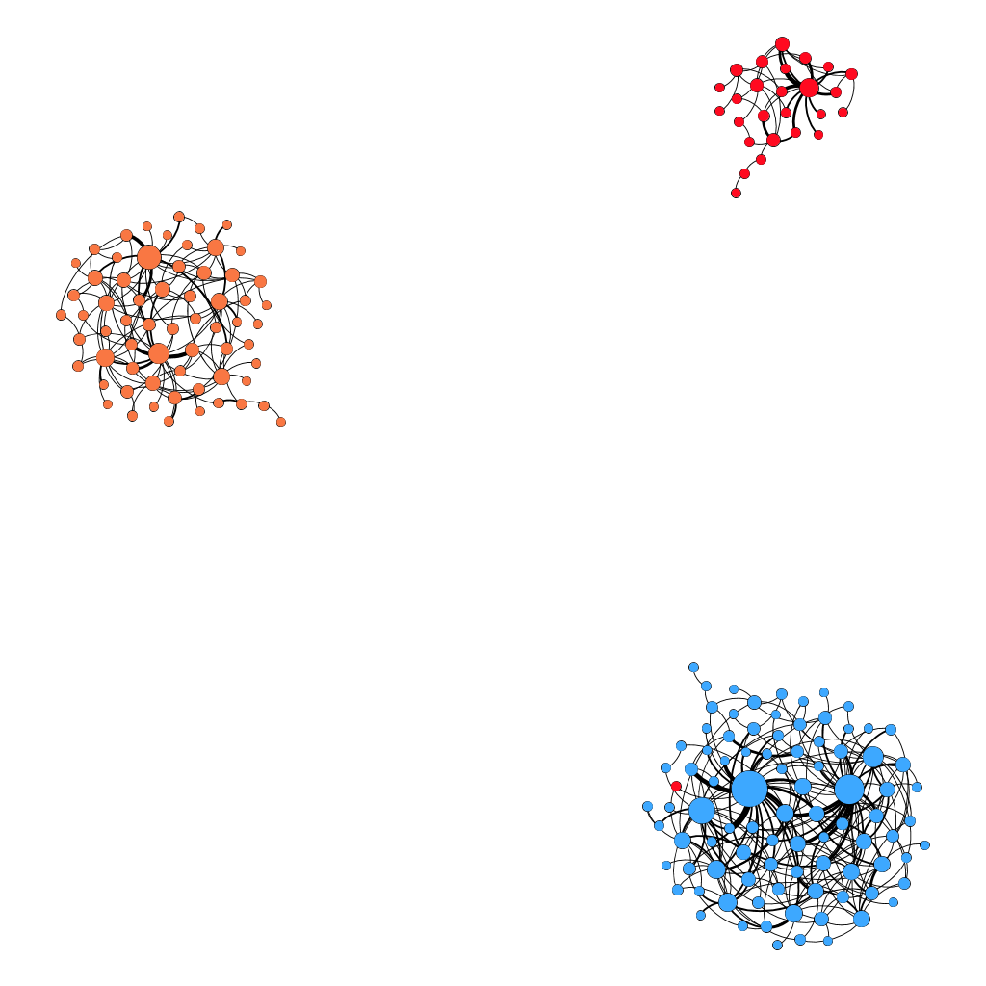
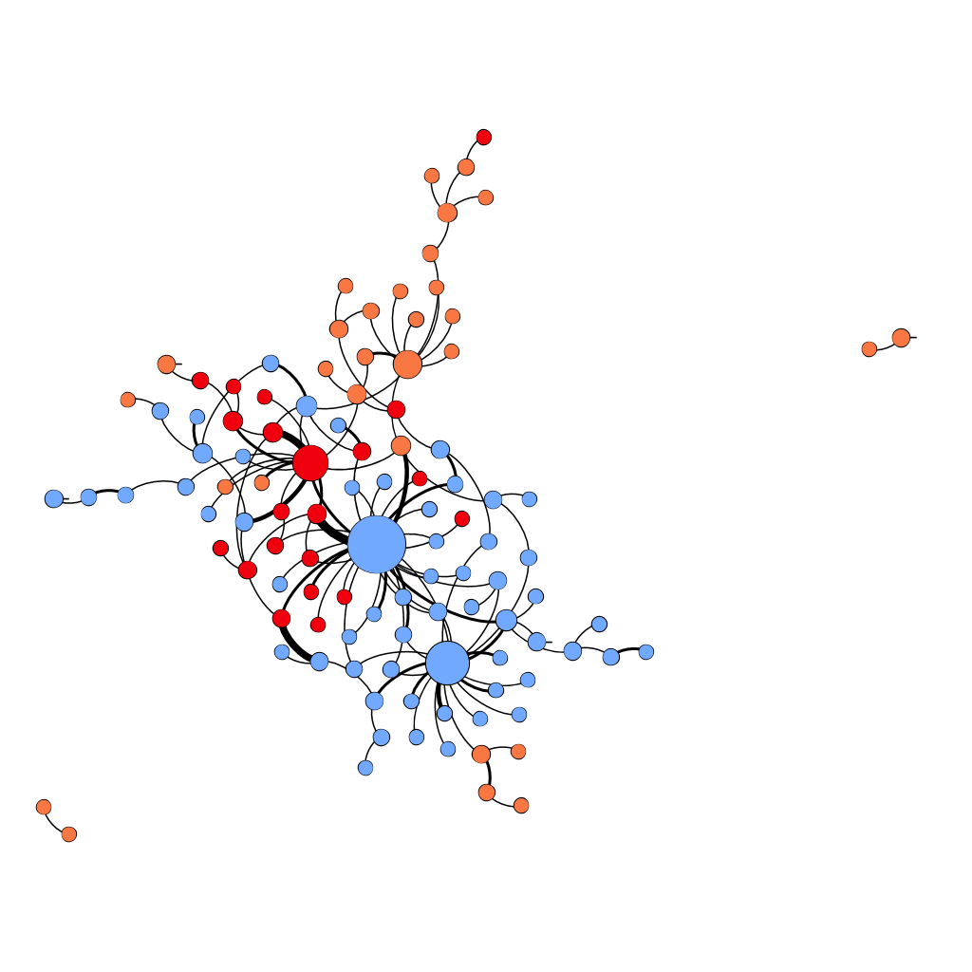
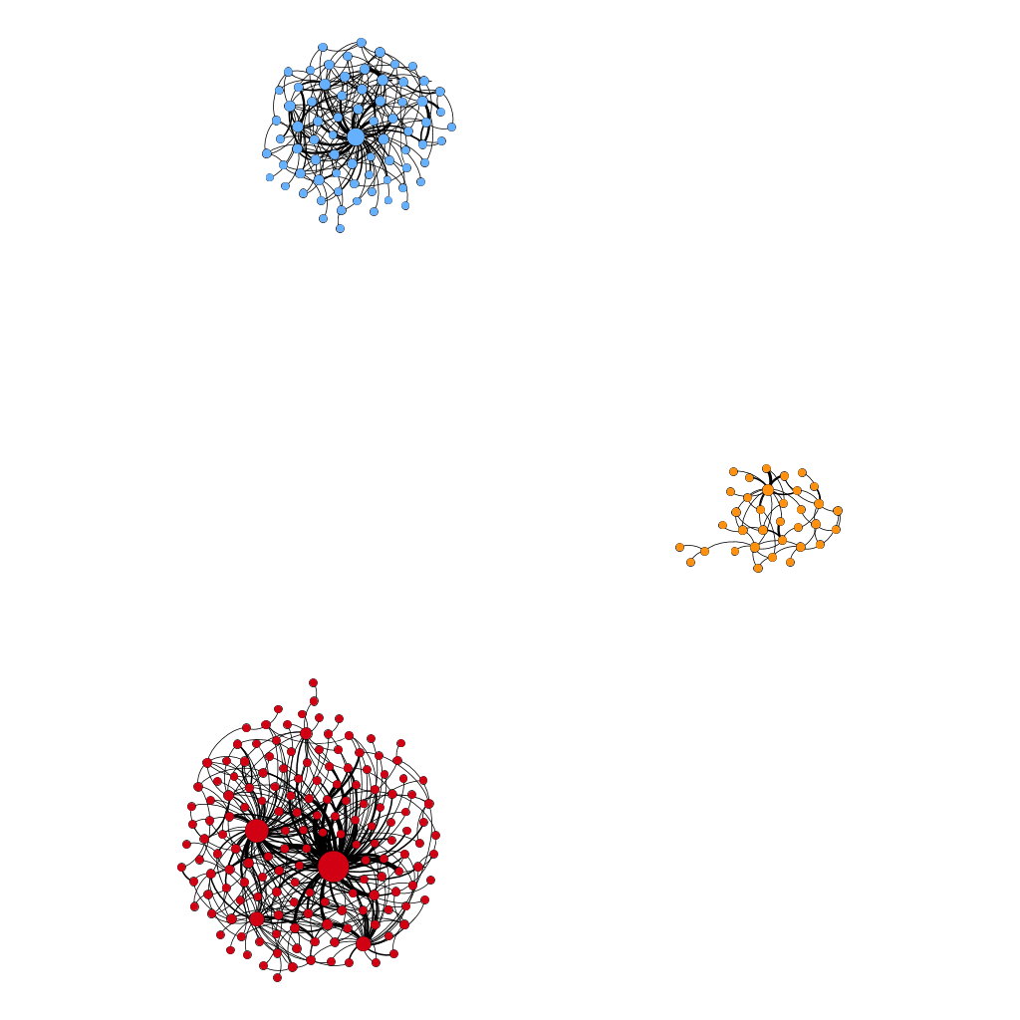
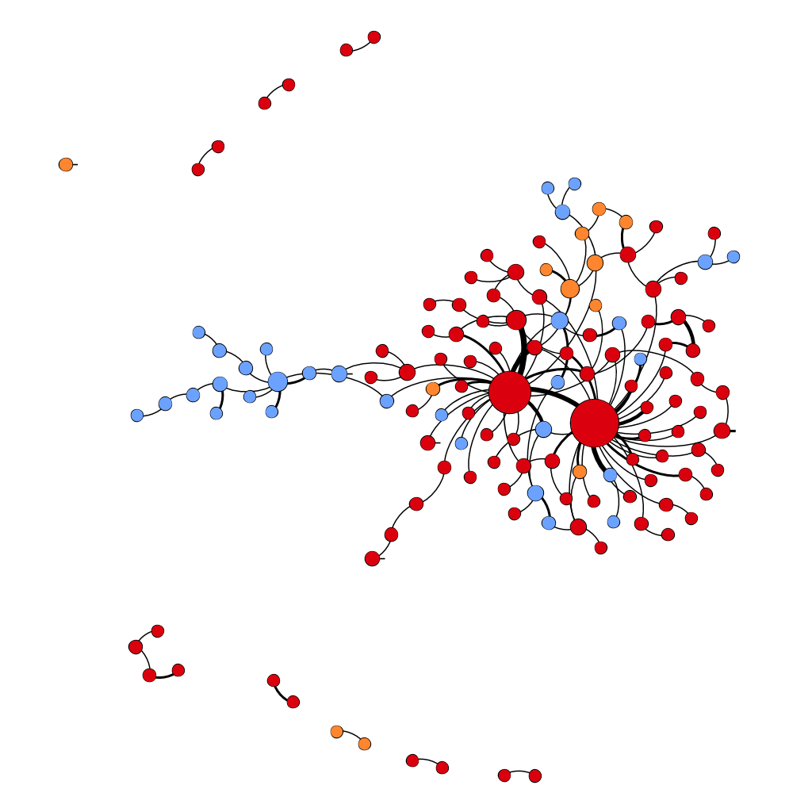
Issue-Based Polarization Cases - #budget
2011 Parliament Retweet
2011 Parliament Mention
2015 Parliament Retweet
2015 Parliament Mention
Polarization: 0.992
Polarization: 0.74
Polarization: 1.0
Polarization: 0.765
Liberal
NDP
Conservative
Retweet networks are almost perfectly polarized. Almost no cross-party retweeting.
Mention networks are less polarized.

Slide 33
Issue-Based Polarization Cases - #budget
2011 Parliament Retweet
2011 Parliament Mention
2015 Parliament Retweet
2015 Parliament Mention
Polarization: 0.992
Polarization: 0.74
Polarization: 1.0
Polarization: 0.765
Liberal
NDP
Conservative
Retweet networks are almost perfectly polarized. Almost no cross-party retweeting.
Mention networks are less polarized.
Conservative central nodes in 2011 parliament while Liberal central nodes in 2015 parliament.

Slide 34
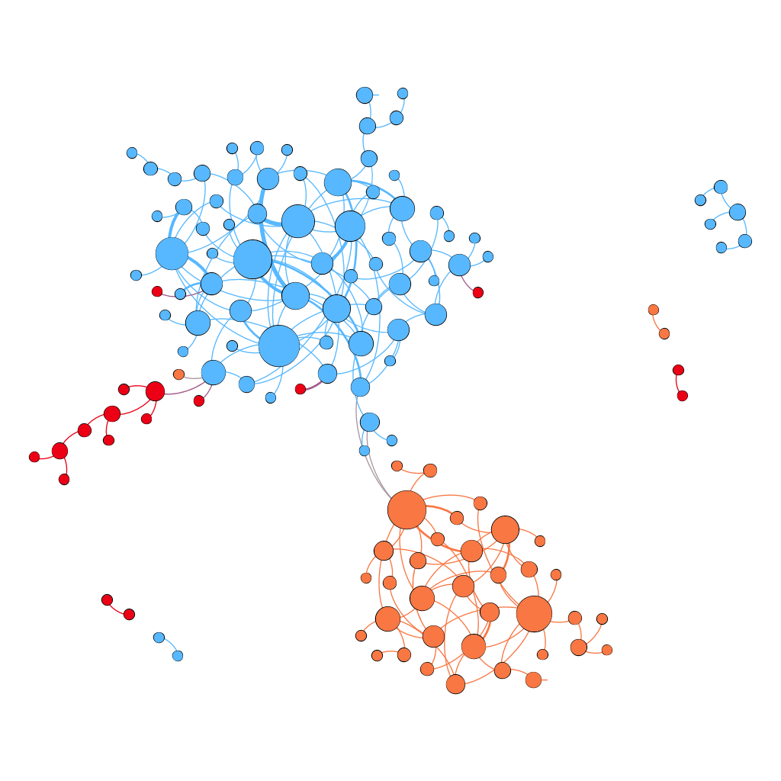
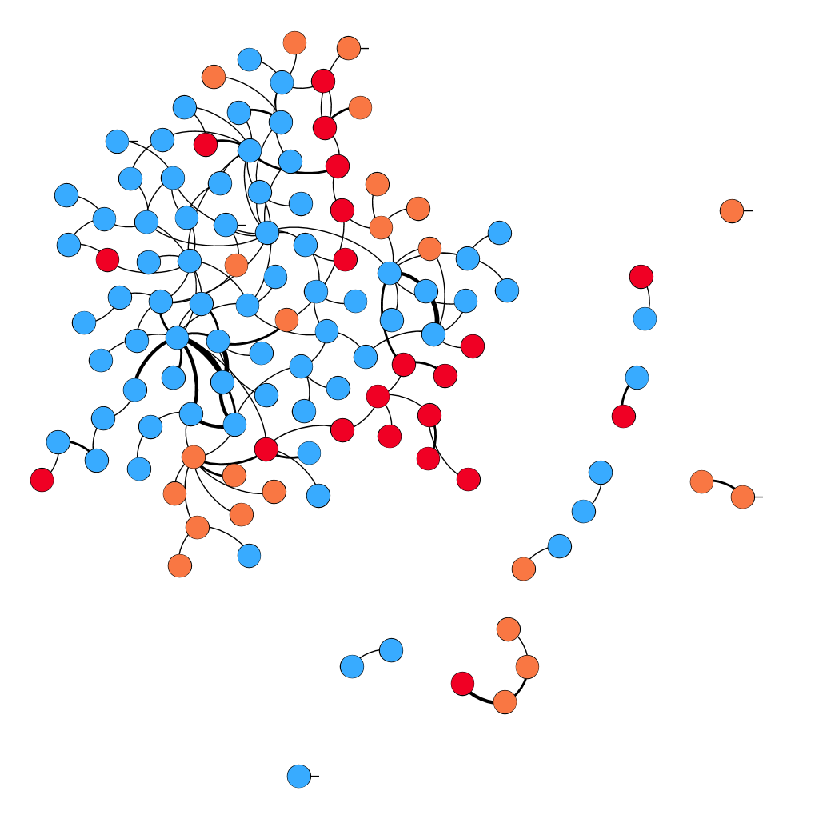
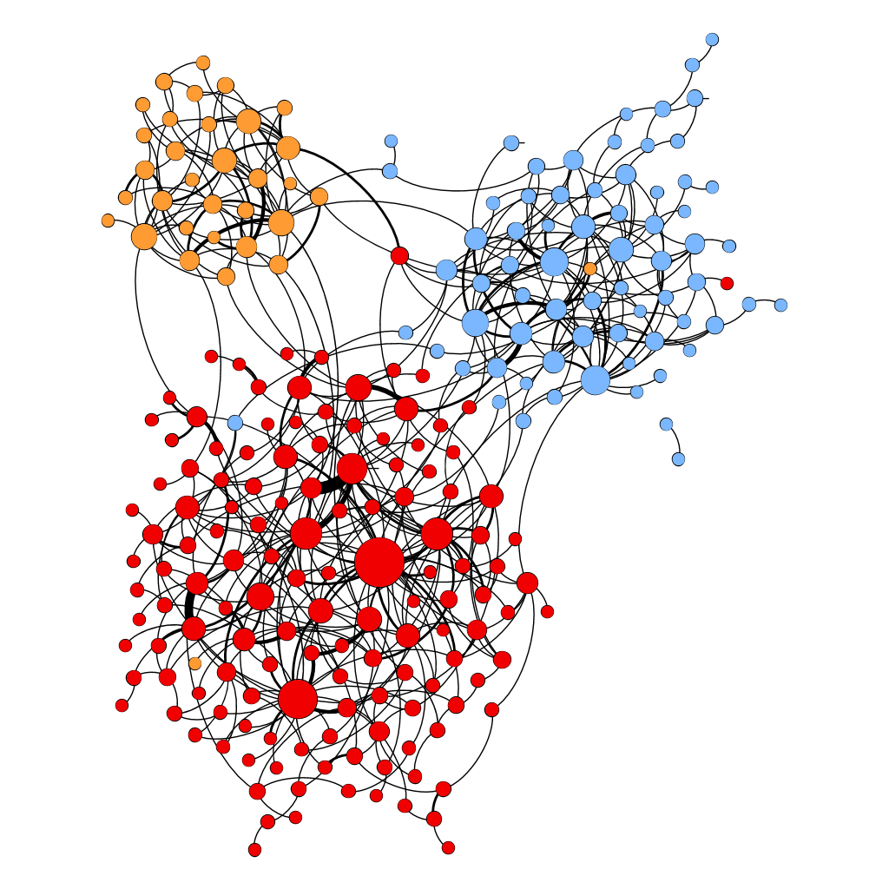
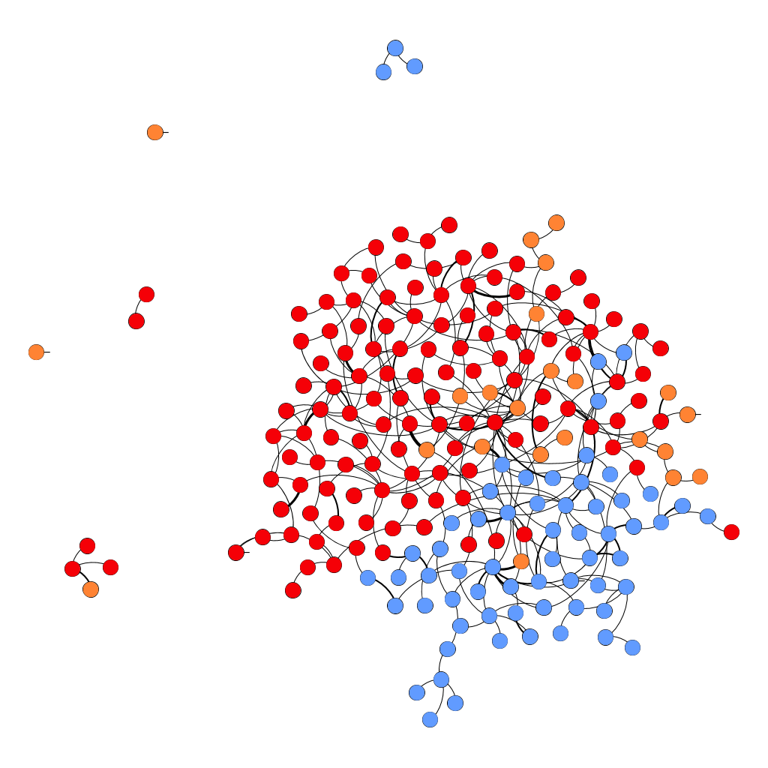
Issue-Based Polarization Cases - committee
2011 Parliament Retweet
2011 Parliament Mention
2015 Parliament Retweet
2015 Parliament Mention
Polarization: 0.905
Polarization: 0.734
Polarization: 0.84
Polarization: 0.77
Liberal
NDP
Conservative
Cross-party retweets are observed.
Mention networks are less polarized. No central figures observed.
Compared to previous 2 issues, less polarization observed. Attributed to bipartisan nature of committees?

Slide 35
Future Directions
Analysing cross party sentiment exchanges in mentionings for polarized and nonpolarized issues.
Comparing with house of commons debates.
openparliament.ca
Applying the same analysis for two recent elections dataset from United Kingdom and Turkey referendum
Turkey referendum with 2 sides
 | United Kingdom Election | Turkey Referendum
Tweets | ~9M (8,837,571) | 851,870
Users | ~2M (1,999,428) | 236,360
Time Range | 05/31 - 06/20 | 04/07 - 04/26

Slide 36
Thank you!

Slide 37
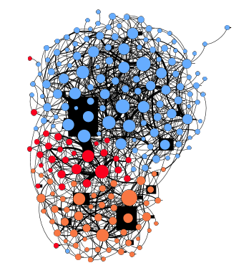
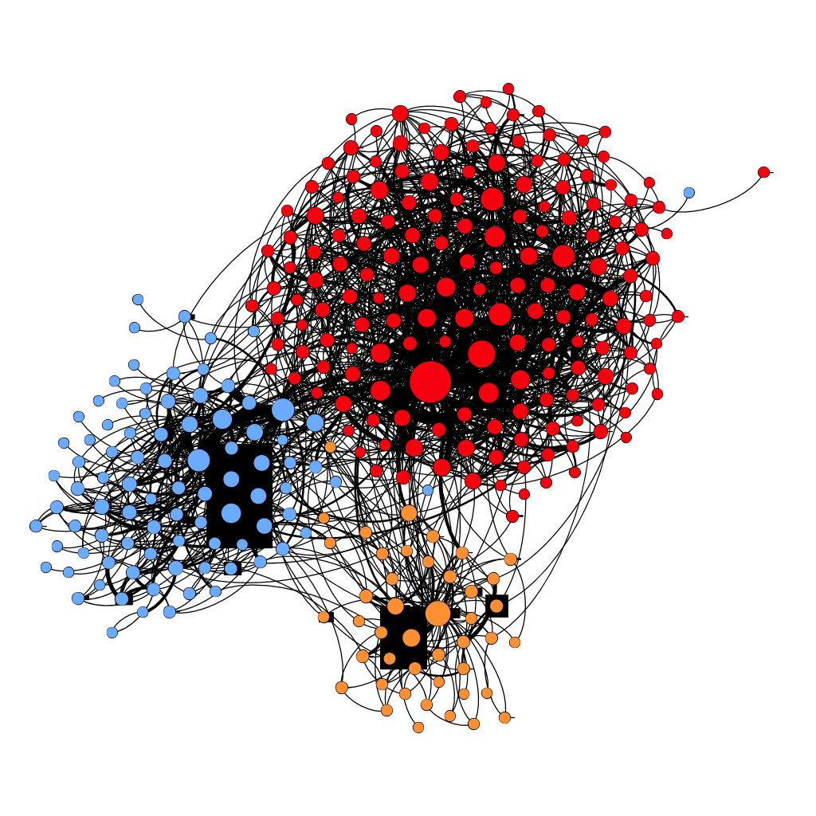
Thank you!
2011 Parliament “thanks”
2015 Parliament “thanks”
Polarization: 0.678
Polarization: 0.765

